Slide 1


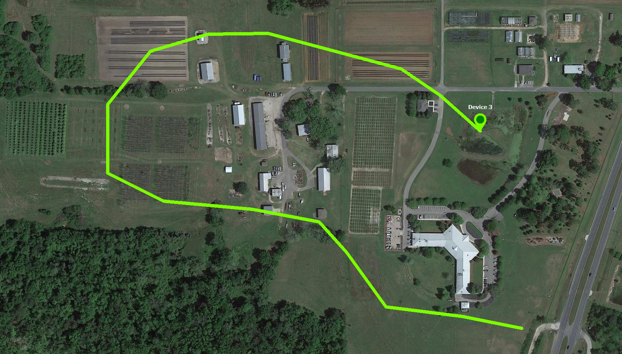
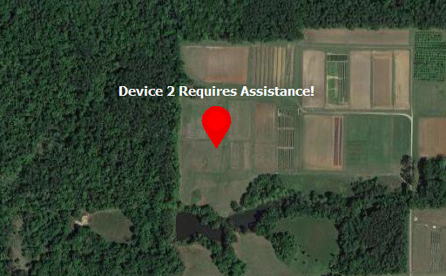
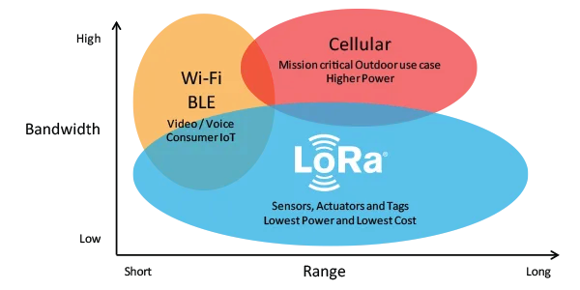
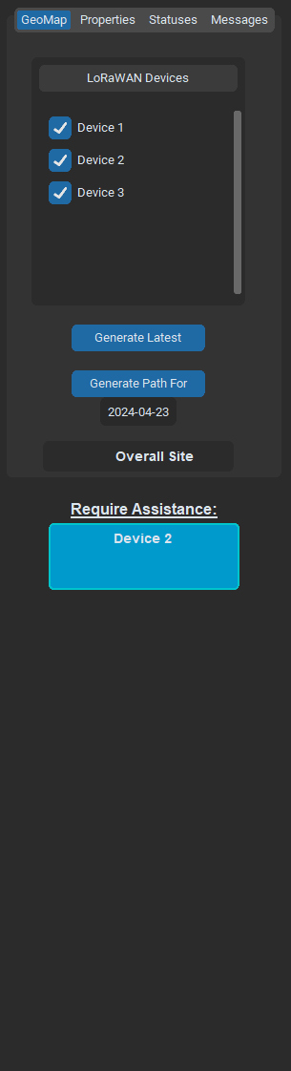
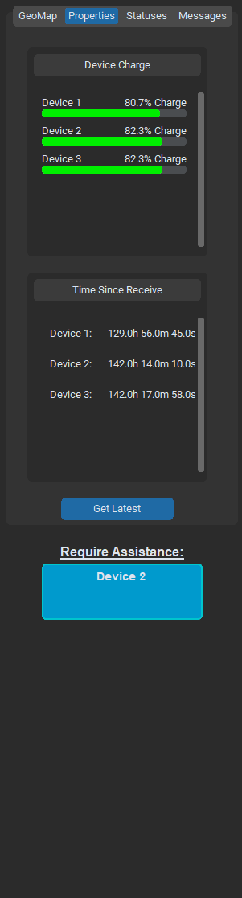
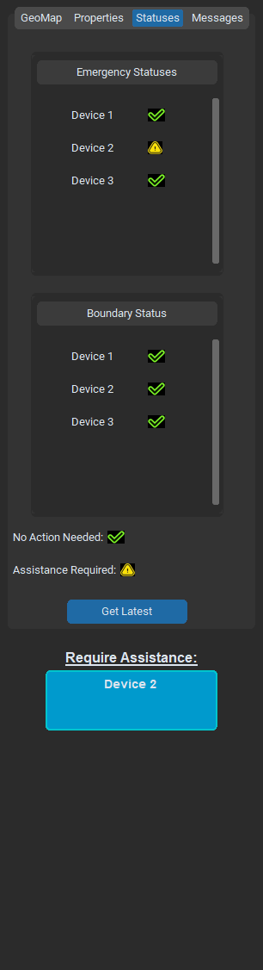
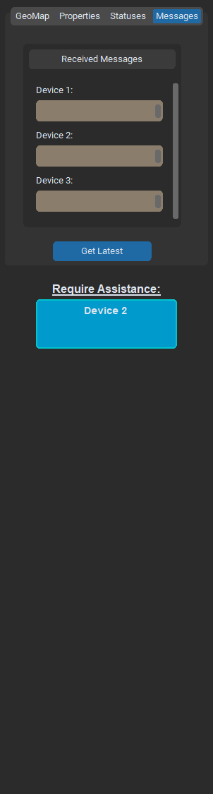
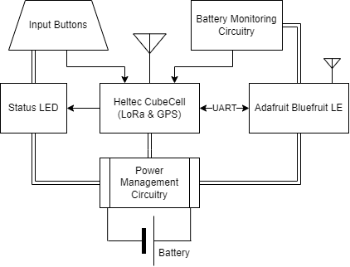
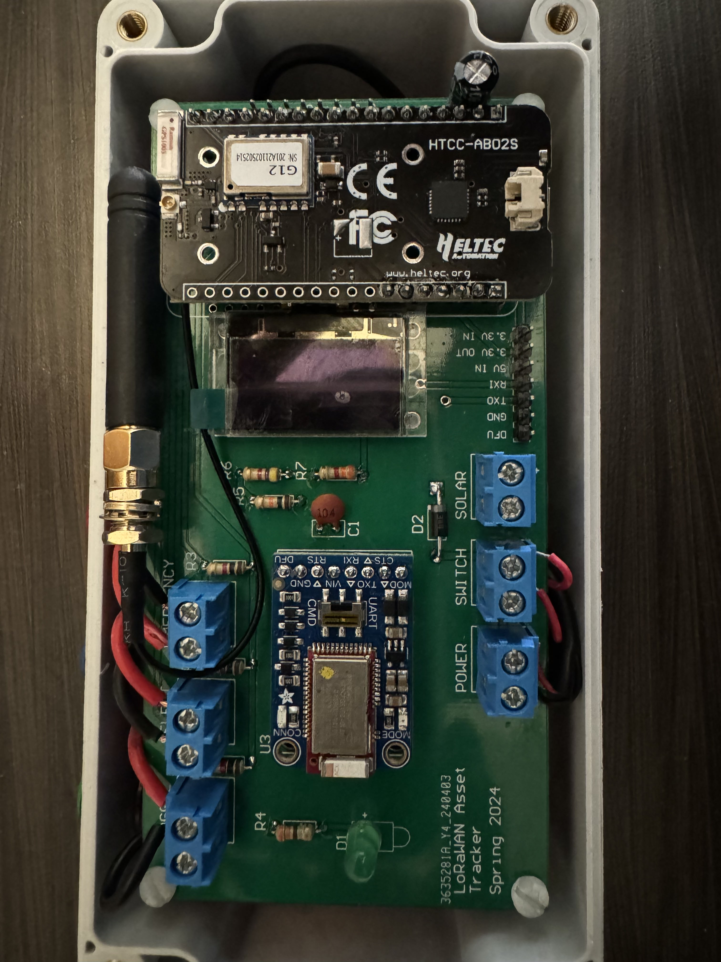
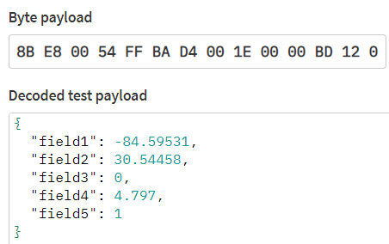
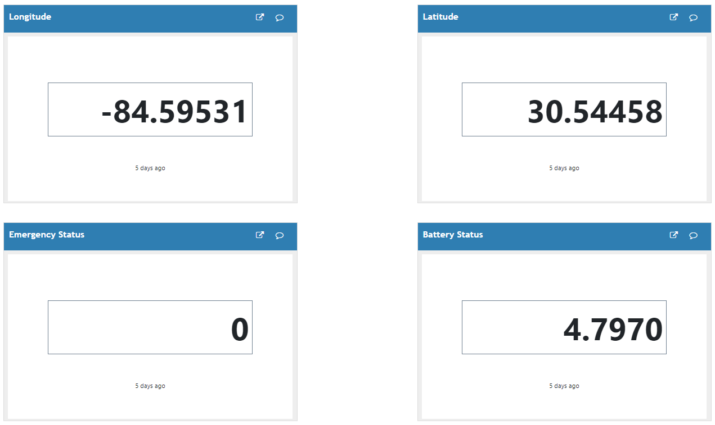
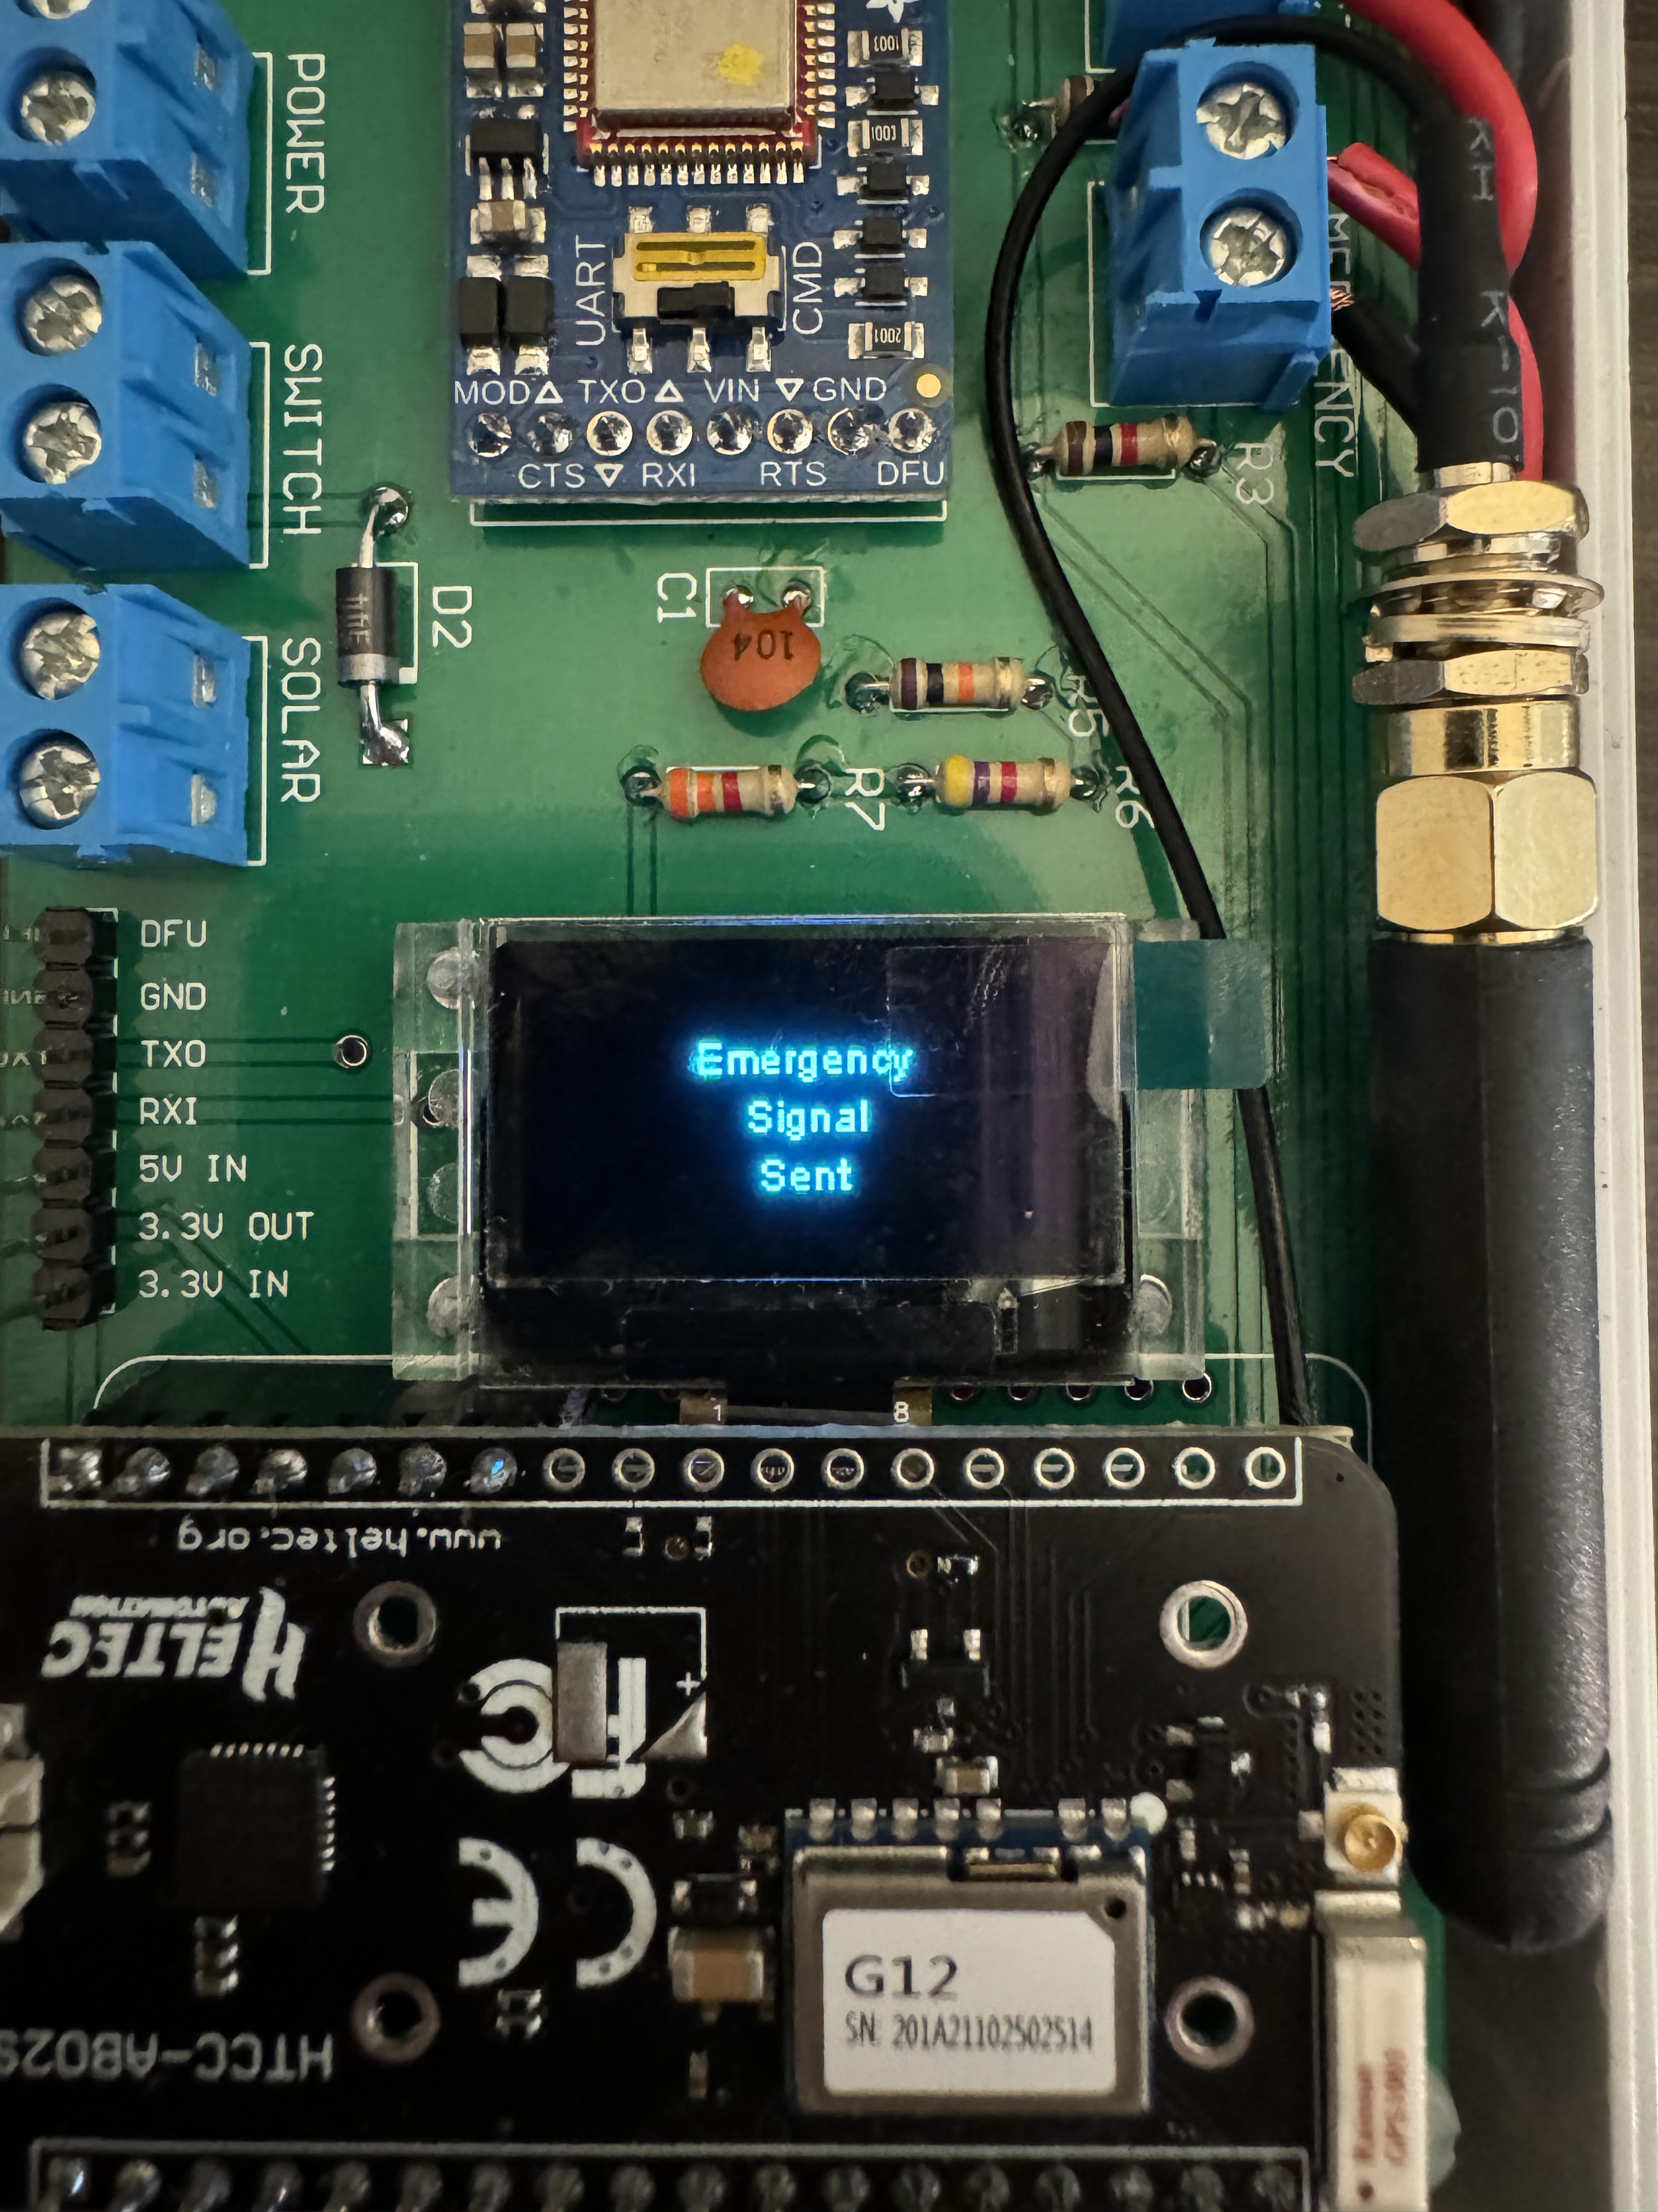
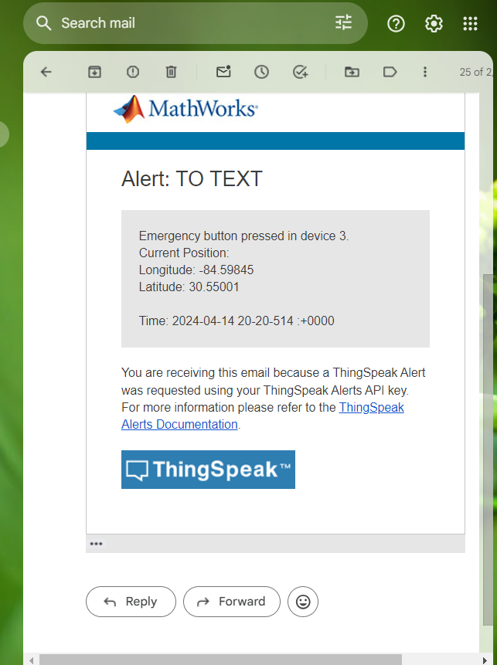
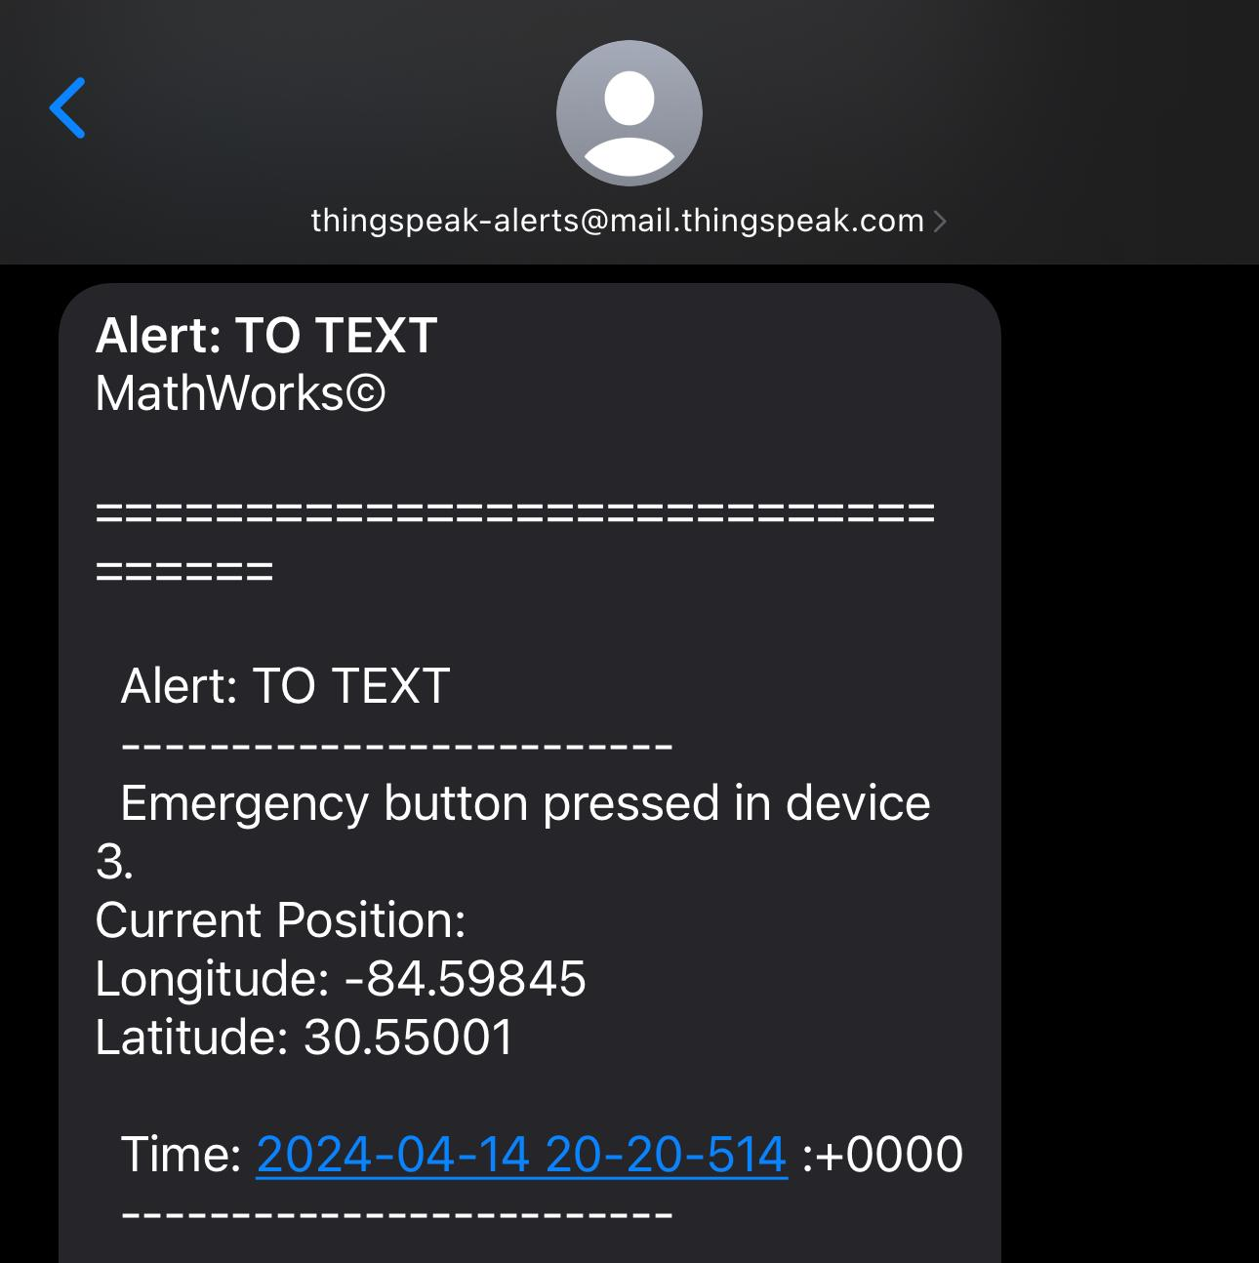
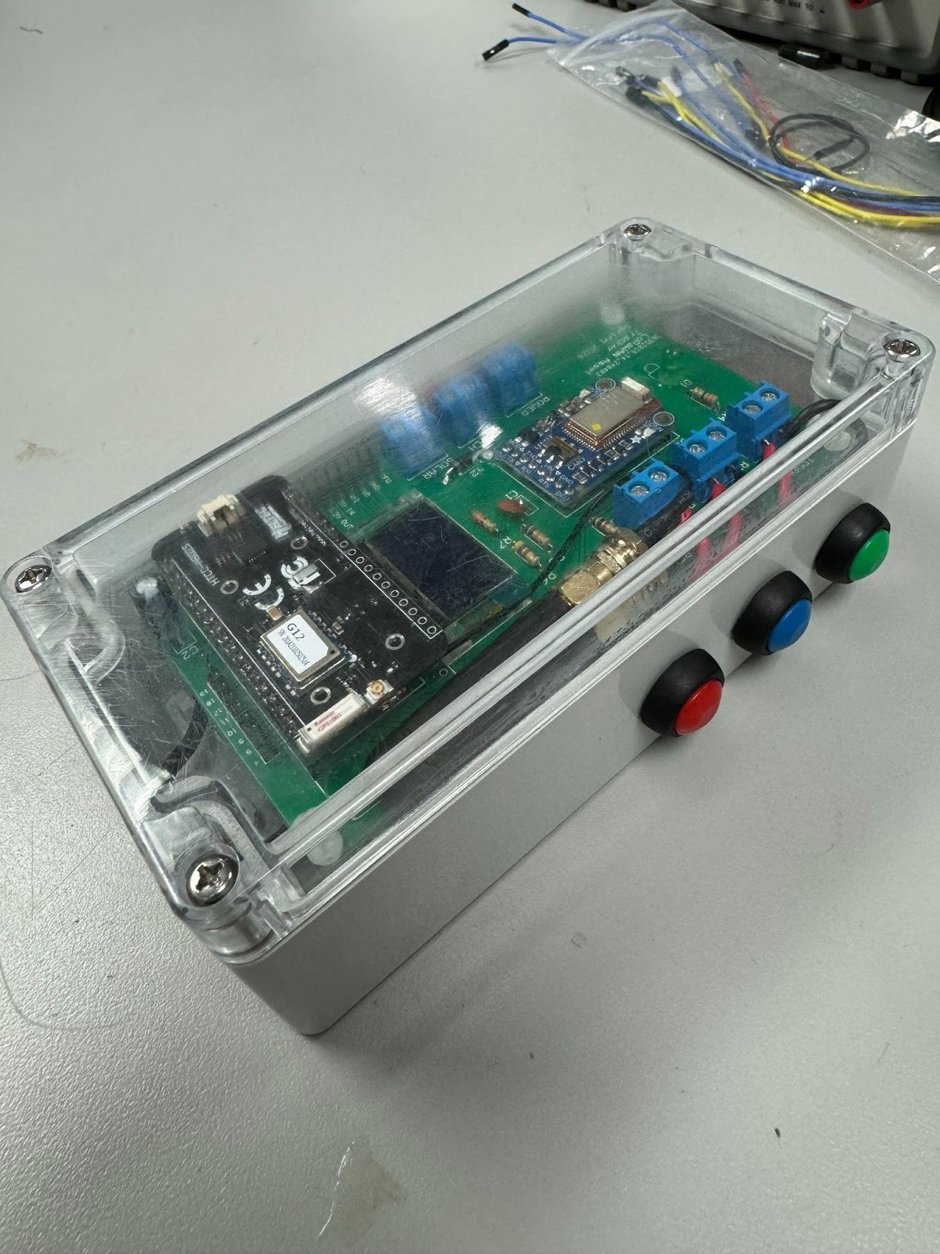
LoRaWAN Asset Tracker and Emergency Button
Senior Design Team: William Lorenzen, Justin Nagovskiy, Maria Barrera
Faculty Sponsor: William Eisenstadt
Herbert Wertheim College of Engineering, University of Florida, Gainesville, FL
Introduction and Background
System Architecture and Software
Python GUI
The agricultural sector faces safety challenges, with high fatality rates and difficulties in equipment surveillance due to vast farmland and unreliable connectivity [1].
Our solution addresses these challenges with a multifunctional device serving as both a personal emergency button and an asset tracker.
Incorporating LoRaWAN communication ensures reliable connectivity in areas with limited network infrastructure.
End
Nodes
Heltec AB02S based waterproof embedded devices
Collect end node data, format into individual bytes, and send data to the gateway every specified period, and go into low power mode afterwards
Gateway
Raspberry Pi 4 SX1303 LoRaWAN Gateway
Forwards end node data to the network server through the internet
Network Server
TheThingsStack - a LoRaWAN network that securely manages applications, end nodes, and gateways
Receives uplink messages from gateway, decrypts and decodes them, and forwards uplink data to application servers
Application Server
Application
ThingSpeak – an IoT platform with MATLAB analytics
Python GUI that extracts data from ThingSpeak channels via the ThingSpeak API and displays end node data
Data received from TTN is monitored on ThingSpeak and triggers email and text message alerts when an emergency signal is sent
Visualizes end node data in intuitive manner and plots end node GPS data on geolocation map
The Python GUI extracts data from ThingSpeak, generating a dynamic and fully interactive map displaying various device locations and paths, as well as presenting device details such as status, battery charge, properties, messages, and previously collected data, all within a single interface.
LoRaWAN
LoRaWAN (Long Range Wide Area Network) is a networking protocol designed for low power and wide area applications, making it suitable for Internet of Things (IoT) applications.
Compared to cellular or Wi-Fi, this communication protocol and associated LoRa hardware is lower power, more cost-effective, and longer range.
Plotting of Current and Previous End Node GPS Data
Highlighting End Nodes that Triggered Emergency Button
LoRaWAN vs Cellular and WiFi [2]
Hardware
Hardware can be grouped into 6 subsystems: the Heltec CubeCell, the Adafruit Bluefruit BLE module, the power management circuit, the battery monitoring circuit, the input buttons, and status LED.
In addition, a PCB joins the subsystems together. The entire system is also contained within a waterproof plastic box enclosure.
Hardware block diagram
The end node sends 14 bytes of data to the LoRaWAN gateway, which is then forwarded to the TTN server. This data is decoded by a custom JavaScript payload formatter and transmitted to a dedicated ThingSpeak channel, where the end node GPS data, battery voltage, and emergency status can be viewed.
Display of End Node Charge Percentage, Statuses, Uplink Messages, Time Since Last Received, and Plotting Capabilities
The CubeCell is responsible for much of the system's functionality.
It consists of the microcontroller, GPS module and antenna, LoRa module, and an OLED display.
It interfaces with each of the other subsystems in the project.
Future Work
Miniaturization of end node
Addition of environmental sensors and other peripherals to end node
Transition from Miady battery to LiPo battery to power end node for more accurate mapping of end node voltage to battery percentage
Improvement of LoRaWAN gateway – possible transition to use of Raspberry Pi 5 for SX1303 Gateway to avoid the heat generated by the Raspberry Pi 4
Extensive testing in field and optimization of power consumption
Top view of system
The Bluefruit BLE is a Bluetooth Low Energy (LE) module allowing communication with a mobile phone.
This is used to notify the system that a mobile device is nearby.
The device is powered by a rechargeable 5 V, 2.4 A LiPo power bank/battery.
Sample data decoded in TTN (left) which is then sent to a ThingSpeak channel (right).
When the emergency signal is triggered, an alert is sent via email and text, indicating the the device that requires assistance along with its current GPS coordinates
References
OLED display
[1] U.S. BUREAU OF LABOR STATISTICS, “Census of Fatal Occupational Injuries Summary, 2022,” Bls.gov, 2023. https://www.bls.gov/news.release/cfoi.nr0.htm
[2] “What are LoRa and LoRaWAN?,” The Things Network. https://www.thethingsnetwork.org/docs/lorawan/what-is-lorawan/#:~:text=LoRaWAN%20is%20suitable%20for%20transmitting
The enclosure is a waterproof gray polycarbonate box large enough to fit all the required parts of the system.
The cover is transparent, allowing the user to see the display and status LED through the box.
The buttons and switch are waterproof and are mounted securely to the box
ThingSpeak alert sent via email (left) and text message (right).
Featuring a Bluetooth Low Energy Module, the end node can receive messages from a field worker’s phone and send corresponding uplink messages to the server, to be viewed on the application GUI.
Messages can be sent back from the network server to the end node via scheduled downlinks, which can be viewed by a field worker on the end node’s OLED display.
This can facilitate communication between field workers and managers via LoRaWAN in locations that do not have cellular connection.
Acknowledgements
We would like to thank our senior design faculty sponsor, Dr. Eisenstadt, for his guidance on this IoT4Ag project. We would also like to thank Professor Stapleton for his help with hardware design, Dr. Small for his user interface suggestions, and Eric Liebner for help with the box enclosure.
View of system within enclosure

